Slide 1

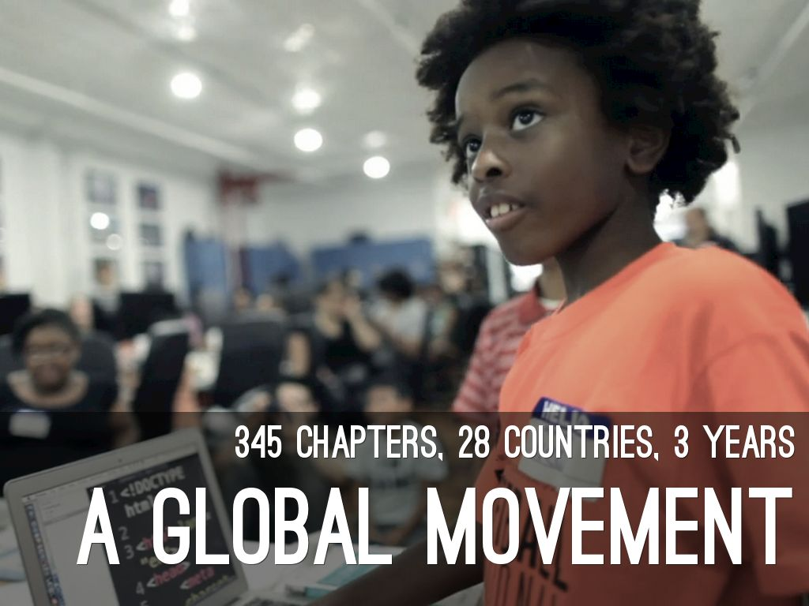
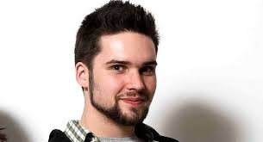

Slide 2
What is CoderDojo?
A global community of free programming clubs
Any skills level, usually age 10-17
Any duration, any frequency
Collaborative & fun place for kids interested in computers to work together
There is a Charter/Recommended Practices

Slide 3
Three Things Needed
LOCATION to host dojo
CHAMPION(s) to administer and technically guide
MENTORS to assist, walk around, help and keep order
That’s it... “if you build it, they will come”.

Slide 4
How to find a host Location
Look for community accessible locations:
Public Library
School
Business with large meeting room
Must have VERY GOOD WiFi capability and outlets
Capacity for students, parents, mentors, and equipment
Must ensure security and child safety

Slide 5
Recruiting Mentors
Start locally
High School Juniors/Seniors needing Community Service hours
Colleges & Universities (Comp.Science depts)
Local IT Businesses
Parents who work in IT
District Teachers / Local PTA’s
LinkedIn Groups / Alumni organizations

Slide 6
Attracting Attendees -the easy part!
Register your dojo at zen.coderdojo.com (parents will look here 1st!)
Library website/newsletter/postings
Create a Facebook Group page – parents are likely to visit those
Local newspaper calendar of events
Flyers at local schools / PTA’s
Email to local school science and computer teachers

Slide 7
Hardware
Attendees are asked to bring their own laptops
Sharing isn’t ideal, but can work in a bind
iPads not advisable, Chromebooks work well
You should have spare laptops available
Many organizations that will donate if asked
Look for local IT businesses
CodeStarter.com

Slide 8
Our sessions so far
June 2014 – Intro to SCRATCH
July 2014 – PONG made with SCRATCH
Aug 2014 – Platform game with SCRATCH
Sept 2014 – Intro to Webpages using HTML
Oct 2014 – Intro to JavaScript
Nov, Dec – Modding “MINECRAFT” with Javascript

Slide 9
Before our session take place
Decide on theme or project
Look for engaging video to start session
2 weeks prior - Decide what books might be useful and have Library order available BCCLS copies (show books)
1 week prior – Get attendee list from library and if spots are open, send email to non-attendees telling them spots are still open
1 week prior – Send mentors a reminder plus a summary of the project
2 days prior – Send reminder to attendees

Slide 10
What our 2-hr sessions look like
Sign-in & Welcome (especially for newcomers & parents) – 5 mins
Short video (3-4 min) addressing topic
June – MIT MediaLab SCRATCH video
July – History of the Video Game video
Aug – Platformer Awards of the Year
Sept – What is the World Wide Web?
Walk through of Project – 1.25 hrs
Presentations – 30 mins
Encourage book sign-out and hand out take-home flyer – 5 mins

Slide 11
Our metrics
Nothing globally right now (in the works)
Keep a rolling excel list of attendee/mentor data
Helps you plan for needed spare laptops
Helps you re-connect with parents from past sessions who may have forgotten to register for upcoming sessions

Slide 12
Social Media
Facebook
Ridgefield Park CoderDojo (Facebook page)
These FB groups post interesting articles, stats, and coding project ideas that you can share
CoderDojo
Code.org
Make.com
Twitter
@coderdojo
@RP_NJCoderdojo
@CoderdojoNYC

Slide 13
CoderDojo-led resources
Charter/Recommended Practices
Kata
Monthly calls
Sushi
Laminated cards

Slide 14
Other Resources
scratch.mit.edu
Brackets.io editor
GitHub.com/RP-NJCoderdojo (this is our repository of logos, projects, links, etc. for you to use as you’d like)
Please contact us at any time:
Anabelle Forte (anabelleforte@alum.rpi.edu)
Arnie Forte (arnieforte@gmail.com)

